Slide 1
5.3b Thermal Physics
Gases
Breithaupt pages 210 to 218
January 31st 2011

Slide 2
AQA A2 Specification
Lessons | Topics
1 to 4 | Ideal gases Gas laws as experimental relationships between p, V, T and mass. Concept of absolute zero of temperature. Ideal gas equation as pV = nRT for n moles and as pV = NkT for N molecules. Avogadro constant N_{A}, molar gas constant R, Boltzmann constant k. Molar mass and molecular mass.
5 to 7 | Molecular kinetic theory model Explanation of relationships between p, V and T in terms of a simple molecular model. Assumptions leading to and derivation of pV =⅓Nmc²_{rms} Average molecular kinetic energy ½mc²_{rms} = ³/₂ kT = 3RT / 2 N_{A}

Slide 3
Pressure, p
pressure = force p = F
area A
units:
force – newtons (N)
area – metres squared (m²)
pressure – pascal (Pa)
note:
1 Pa is the same as 1 Nm⁻²
Standard atmospheric pressure = 101 kPa

Slide 4
Complete:
force (N) | area | pressure
40 N | 8 m² | Pa
500 N | 20 m² | 25 Pa
400 N | 5 m² | 80 Pa
20 N | 2 cm² | 100 kPa
6 N | 2 mm² | 3 MPa
5 pN | 5 μm² | 1 Nm⁻²
5
20
400
100
2
5

Slide 5
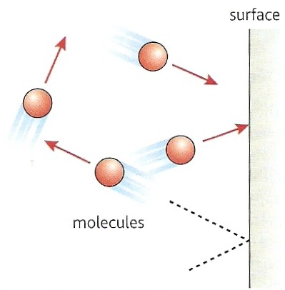
How a gas exerts pressure
A gas consists of molecules in constant random motion.
When a molecule collides with a surface it undergoes a momentum change as it reverses direction.
By Newton’s 2nd and 3rd laws the surface therefore experiences a force from the colliding molecule.
The pressure exerted by the gas is equal to the total force exerted by the molecules on a unit area of the surface.
pressure = force / area

Slide 6
The experimental gas laws
These state how the pressure, p volume, V and the absolute temperature, T of an ideal gas relate to each other.
Real gases at relatively low pressures and well above their condensation temperature behave like an ideal gas.
Air at normal temperature (20ºC) and at standard atmospheric pressure (101 k Pa) is a good approximation to an ideal gas.

Slide 7
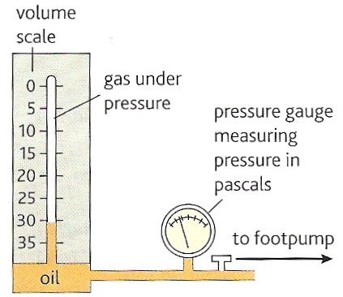
Boyle’s law
For a fixed mass of gas at a constant temperature:
pV = constant
When a gas changes pressure from p₁ to p₂ while undergoing a volume change from V₁ to V₂ :
p₁ x V₁ = p₂ x V₂

Slide 8
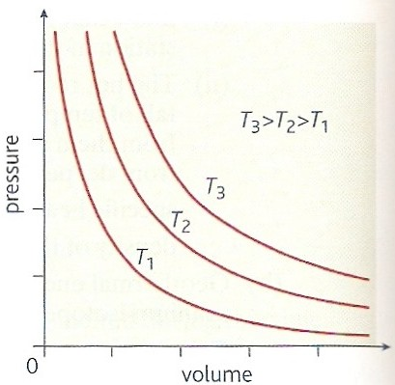
An ideal gas is defined as a gas that obeys Boyle’s law at all pressures.
Real gases do not obey Boyle’s law at very high pressures or when they are cooled to near their condensation point.
Graphs of an ideal gas obeying Boyle’s law at different temperatures.

Slide 9
Boyle’s law question
A gas has an initial volume of 300 m³ at standard atmospheric pressure (100 kPa). Calculate the final volume of this gas if its pressure is increased by 400 kPa at a constant temperature.
Boyle’s law: p₁ x V₁ = p₂ x V₂
100 kPa x 300 m³ = 500 kPa x V₂
30 000 = 500 V₂
V₂ = 30 000 / 500
Final volume = 60 m³

Slide 10
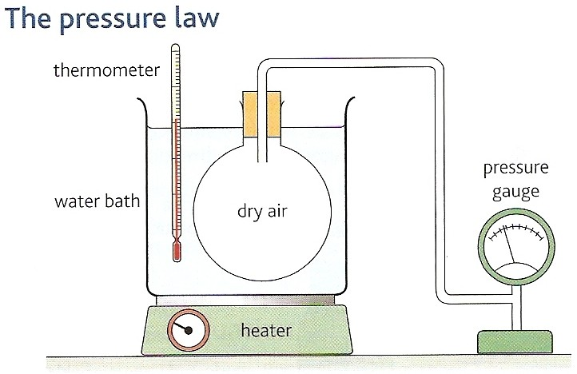
Pressure law
For a fixed mass of gas at a constant volume:
p = constant
T
When a gas changes pressure from p₁ to p₂ while undergoing a temperature change from T₁ to T₂ :
p₁ = p₂
T₁ T₂

Slide 11
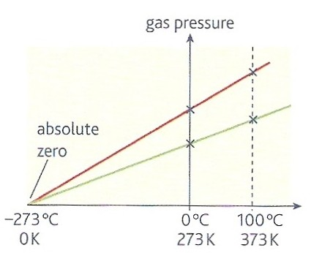
Absolute zero
Absolute zero is the lowest possible temperature.
An object at absolute zero has minimum internal energy.
The graph opposite shows that the pressure of all gases will fall to zero at absolute zero which is approximately - 273ºC.

Slide 12
Pressure law question
A gas has an initial pressure of 100kPa at a temperature of 27ºC. Calculate the final pressure of this gas if its temperature is increased by 300ºC at a constant volume.
Pressure law: p₁ / T₁ = p₂ / T₂
Temperatures must be in kelvin!
so: T₁ = 300K and T₂ = 600K
100 kPa / 300K = p₂ / 600K
p₂ = (100 000 x 600) / 300
Final pressure = 200 kPa

Slide 13
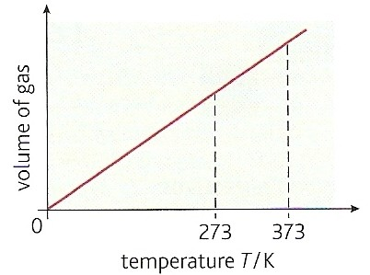
Charles’ law
For a fixed mass of gas at a constant pressure:
V = constant
T
When a gas changes volume from V₁ to V₂ while undergoing a temperature change from T₁ to T₂ :
V₁ = V₂
T₁ T₂
Graph of an ideal gas obeying Charles’ law. The gas volume becomes zero at 0K.

Slide 14
Charles’ law question
A gas has an initial volume of 50m³ at a temperature of 127ºC. Calculate the final temperature required in ºC to decrease its volume to 20m³ at a constant pressure.
Charles’ law: V₁ / T₁ = V₂ / T₂
Temperatures must be in kelvin, so: T₁ = 400K
50m³ / 400K = 20m³ / T₂
T₂ = (20 x 400) / 50
T₂ = 160K
Final temperature = - 113 ºC

Slide 15
Complete:
p₁ / Pa | V₁ / m³ | Temp₁ | p₂ / Pa | V₂ / m³ | Temp₂
100 k | 30 | 20ºC | 600 k | 5 | 20ºC
100 k | 30 | 200 K | 25 k | 30 | 50 K
100 k | 25 | 200 K | 100 k | 75 | 600 K
400 k | 20 | 20ºC | 100 k | 80 | 20ºC
50 k | 80 | 27ºC | 150 k | 80 | 627ºC
100 k | 80 | 27ºC | 100 k | 40 | -123ºC
5
25
75
400
150
-123

Slide 16
Combining the Gas Laws
Combining all three gas laws for a constant mass of gas gives:
pV = a constant
T
So

Slide 17
The Avogadro constant, N_{A}
The Avogadro constant N_{A} is equal to the number of atoms in exactly 12g of the isotope carbon 12.
To 4 s.f. : N_{A} = 6.023 x 10²³

Slide 18
Amount of substance, n
The amount of substance is the quantity of a substance measured in moles.
1 mole (mol) = N_{A} (6.023 x 10²³) particles of a substance.
Number Number
Of = of x N_{A}
particles moles

Slide 19
Molar mass, M
The molar mass of a substance M is equal to mass of one mole of the substance.
The number of moles, n of a substance mass, M_{s} of molar mass, M will be given by:
n = mass of substance = M_{s}
molar mass M
Examples of M :
atoms of carbon 12 isotope = 12g
O₂ molecules made up of oxygen 16 = 32g
CO₂ molecules = 44g

Slide 20
The ideal gas equation
Combining all three gas laws for a constant mass of gas gives:
pV = a constant
T
the constant = nR and so:
pV = nRT – the ideal gas equation
where:
n = number of moles of the gas
R = molar gas constant = 8.31 J K⁻¹ mol⁻¹

Slide 21
Question 1
Calculate the volume of one mole an ideal gas at 0ºC and 101kPa (standard atmospheric pressure)
pV = nRT
becomes: V = nRT / p
temperatures must be in kelvin, so: T = 273K
= (1 mol x 8.31 J K⁻¹ mol⁻¹ x 273K) / 101 000 Pa
= 0.02246 m³
volume = 22.46 dm³ (cubic decimetres OR litres)
This is also known as ‘molar volume’.

Slide 22
Question 2
A fixed mass of gas has its pressure increased from 101 kPa to 303 kPa, its volume by 5 m³ from 1 m³ while its temperature is raised from 20°C. Calculate its final temperature.
pV / T = a constant
can be written: p₁V₁ / T₁ = p₂V₂ / T₂
temperatures must be in kelvin, so: T₁ = 293K
(101k x 1) / 293 = (303k x 6) / T₂
T₂ = (293 x 303k x 6) / (101k x 1)
final temperature = 5274 K

Slide 23
Question 3
A container of volume 2.0 x 10 ⁻³ m³, temperature 20ºC, contains 60g of oxygen of molar mass 32g. Calculate its pressure.
pV = nRT
becomes: p = nRT / V
where: n = M_{s} / M = 60g / 32g = 1.875 mol
temperatures must be in kelvin, so: T = 293K
p = (1.875 x 8.31 x 293) / 0.002
pressure = 2.28 x 10 ⁶ Pa

Slide 24
The Boltzmann constant, k
The number of molecules N = n x N_{A}
which becomes: n = N / N_{A}
so in the ideal gas equation: pV = nRT
becomes: pV = (N / N_{A} ) x RT
= (R / N_{A}) x NT
The Boltzmann constant, k = R / N_{A}
where: k = 1.38 x 10 ⁻²³ J K⁻¹
And so the ideal gas equation can be stated as:
pV = NkT

Slide 25
Question
Estimate the number of air molecules in this room.
[Typical values: room volume = 100m³;
room temperature = 20ºC;
atmospheric pressure = 101 kPa]
pV = NkT
becomes: N = pV / kT
temperatures must be in kelvin, so: T = 293K
= (101 000Pa x 100m³) / (1.38 x 10 ⁻²³ J K⁻¹ x 293K)
number of molecules = 2.4 x 10 ²⁷

Slide 26
The Kinetic theory of gases
The kinetic theory of gases
states that a gas consists of
point molecules
moving about in random motion.

Slide 27
The kinetic theory explanation of how gas pressure changes with volume and temperature
VOLUME
If the volume of a container is decreased:
  There will be a greater number of molecules hitting the inside of the container per second
  A greater force will be exerted
  Pressure will increase
TEMPERATURE
If the temperature of a container is increased:
  Molecules will be moving at greater speeds.
  More molecules will be hitting the inside of the container per second and they will each exert a greater force.
  A greater overall force will be exerted
  Pressure will increase

Slide 28
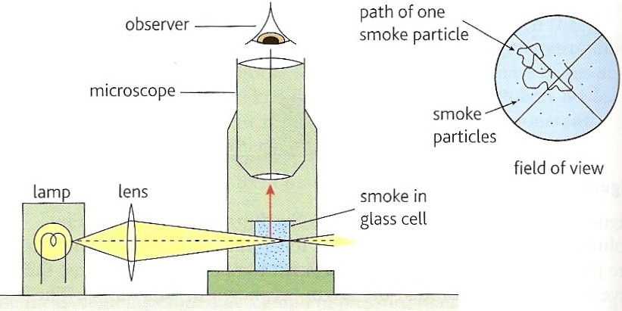
Evidence - Brownian motion
First observed in 1827 with pollen grains in water.
Einstein, in 1905, proved mathematically that the motion of the smaller, invisible air molecules must be as random as the larger, visible smoke particles.

Slide 29
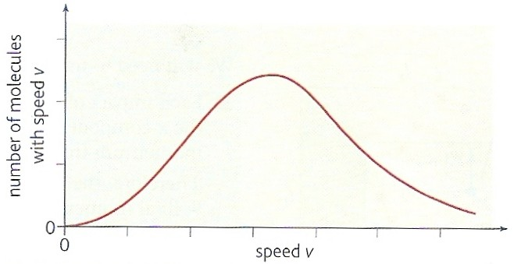
Molecular speed variation
The molecules inside an ideal gas have a continuous spread of speeds as shown by the graph below.
The speed of an individual molecule may change when it collides with another gas molecule but the distribution of speeds remains the same provided the gas temperature does not change.

Slide 30
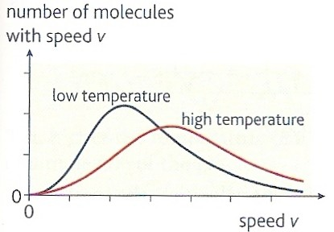
Effect of temperature change

Slide 31
RMS molecular speed, c_{rms}
If a gas contains N molecules
each having speeds c₁ + c₂ + c₃ + …. c_{N}
then the ROOT MEAN SQUARE speed, c_{rms} of molecules is given by:
c_{rms} = (c₁² + c₂² + c₃² + …. c_{N}²)
N

Slide 32
Question
Calculate the RMS speed of four molecules having speeds 300, 340, 350 and 380 ms ⁻¹.
Squaring speeds:
90 000; 115 600; 122 500; 144 400
Mean of the squares:
(90 000 + 115 600 +122 500 +144 400) / 4
= 472 500 / 4 = 118 125
Root of the mean of the squares:
= √118 125
RMS speed = 344 ms⁻¹

Slide 33
The kinetic theory equation
For an ideal gas containing N identical molecules, each of mass, m in a container of volume, V, the pressure, p of the gas is given by:
pV = ⅓ Nm(c_{rms})²

Slide 34
Question 1
A container of volume 0.05m³ has 0.4kg of an ideal gas at a pressure of 2.0 x 10 ⁷ Pa. Calculate the RMS speed of the gas molecules.
pV = ⅓ Nm(c_{rms})²
becomes: (c_{rms})² = 3pV / Nm
Nm = mass of the gas
(c_{rms})² = (3 x 2.0 x 10⁷ x 0.05) / 0.4
= 7.5 x 10 ⁶ m²s⁻²
RMS speed = 2 740 ms⁻¹

Slide 35
Question 2
Show that the kinetic theory equation can be written: p = ⅓ ρ(c_{rms})² where, ρ is the density of the gas. Use this equation to estimate the RMS speed of air molecules at 0°C and 101kPa when the density of air is: ρ_{air} = 1.3 kgm⁻³. Comment on your answer.
Proof:
pV = ⅓ Nm(c_{rms})²
becomes: p = ⅓ (Nm/V) (c_{rms})²
(Nm/V) = (mass/volume of the gas) = density
and so: p = ⅓ ρ(c_{rms})²

Slide 36
RMS speed for air:
(c_{rms})² = 3 p / ρ
= (3 x 101 000 Pa) / 1.3
= 2.33 x 10 ⁵ m²s⁻²
RMS speed = 483 ms⁻¹
Comment:
This a little greater than the speed of sound in air at 0°C (330 ms⁻¹)

Slide 37
Average molecular kinetic energy
Combining pV = ⅓ Nm (c_{rms} )² with pV = NkT
gives: ⅓ Nm (c_{rms} )² = NkT
for one average molecule: ⅓ m (c_{rms} )² = kT
multiplying both sides by ³/₂
⅓ x ³/₂ m (c_{rms} )² = ³/₂ kT
average molecular kinetic energy, ¹/₂ m (c_{rms} )² = ³/₂ kT
Note that the average molecular kinetic energy is proportional to the absolute temperature.
also as k = R / N_{A} ¹/₂ m (c_{rms} )² = 3RT / 2N_{A}

Slide 38
Question
Calculate the mean ke of air molecules at 0ºC. Use this answer to calculate the RMS speed of the O₂ and CO₂ molecules. (M = 32g and 44g respectively)
[k = 1.38 x 10 ⁻²³ J K⁻¹; N_{A} = 6.023 x 10²³]
Mean KE:
¹/₂ m (c_{rms} )² = ³/₂ kT
= 1.5 x 1.38 x 10 ⁻²³ J K⁻¹ x 273K
mean molecular ke = 5.65 x 10 ⁻ ²¹ J

Slide 39
Oxygen RMS Speed:
¹/₂ m (c_{rms} )² = ³/₂ kT
becomes: (c_{rms} )²
= (2 x 5.65 x 10 ⁻ ²¹ J) / m
mass of O₂ molecule
= 32g / N_{A}
= 0.032 kg / 6.023 x 10²³
= 5.31 x 10 ⁻ ²⁶ kg
(c_{rms} )²
= (2 x 5.65 x 10 ⁻ ²¹ J)
/ 5.31 x 10 ⁻ ²⁶ kg
= 212 806 m²s⁻²
O₂ RMS speed = 461 ms⁻¹
CO₂ RMS Speed:
mass of CO₂ molecule
= 44g / N_{A}
= 0.044 kg / 6.023 x 10²³
= 7.31 x 10 ⁻ ²⁶ kg
(c_{rms} )²
= (2 x 5.65 x 10 ⁻ ²¹ J)
/ 7.31 x 10 ⁻ ²⁶ kg
= 154 582 m²s⁻²
CO₂ RMS speed = 393 ms⁻¹

Slide 40
Assumptions required in order to use the kinetic theory equation
Molecules are points - the volume of the molecules is insignificant compared to the volume of the ideal gas.
Molecules do not attract each other – if they did then the pressure exerted by the gas on its container would be reduced.
Molecules move in constant random motion.
All collisions between gas molecules and their container are elastic – there is no loss of kinetic energy.
The time taken for a collision is much shorter than the time between collisions
Any sample of an ideal gas contains a very large number of molecules.

Slide 41
Derivation of: pV = ⅓ Nm(c_{rms})²
Consider N molecules of an ideal gas each of mass, m in a rectangular box of volume, V of dimensions l_{x}, l_{y}, and l_{z}.
Let u₁, v₁ and w₁, represent the velocity components of one of these molecules in the x, y and z directions, respectively.
The speed, c₁ of this molecule is given by:
c₁² = u₁² + v₁² + w₁²
l_{x}
w₁
l_{z}
u₁
v₁
z
y
l_{y}
x

Slide 42
Each impact on the right hand face of the box reverses the x-component of the velocity from +u₁ to - u₁
Therefore the x-component of its momentum changes from +mu₁ to –mu₁.
The momentum change
= final – initial momentum
= (–mu₁) – (+mu₁) = -2mu₁.
Let time, t be the time between successive impacts on this face.
Therefore as: u₁= 2 l_{x} / t
And so: t = 2 l_{x} / u₁
l_{x}
w₁
w₁
w₁
w₁
w₁
w₁
- u₁
l_{z}
- u₁
- u₁
v₁
u₁
u₁
u₁
v₁
v₁
v₁
v₁
v₁
z
y
l_{y}
x

Slide 43
From Newton’s 2nd law of motion, the force exerted on the molecule during its collision with the box
= momentum change / time taken
= - 2mu₁ / t
= - 2mu₁ / (2 l_{x} / u₁)
= - mu₁² / l_{x}
From Newton’s 3rd law of motion the force, F₁ exerted ON THE BOX is in the opposite direction:
F₁ = + mu₁² / l_{x}
l_{x}
w₁
- u₁
l_{z}
v₁
l_{y}

Slide 44
but: pressure = force / area
therefore the pressure, p₁ exerted by the molecule is given by:
p₁ = force / area of face l_{z}, l_{y}
= (mu₁² / l_{x} ) / (l_{y} x l_{z} )
= (mu₁² ) / ( l_{x} x l_{y} x l_{z} )
= (mu₁² ) / ( V )
The total pressure, p exerted by N molecules is given by:
p = (mu₁² ) / ( V )
+ (mu₂² ) / ( V )
+ (mu₃² ) / ( V )
+ …… (mu_{N}² ) / ( V )

Slide 45
p = m [u₁² + u₂² + u₃² + …u_{N}² ] / V
but the mean value of u² , < u² > is given by:
< u² > = [u₁² + u₂² + u₃² + …u_{N}² ] / N
hence:
p = Nm < u² > / V
As the molecules are moving randomly in all directions it can also be shown that:
p = Nm < v² > / V
and
p = Nm < w² > / V

Slide 46
combining all three:
3p = Nm (< u² > + < v² > + < w² > ) / V
but:
c² = u² + v² + w²
and so:
3p = Nm < c² > / V
3p = Nm (c_{rms} )² / V
3pV = Nm (c_{rms} )²
and so:
pV = ⅓ Nm (c_{rms} )²

Slide 47
Internet Links
Brownian Motion - NTNU
Particle model of a solid / liquid / gas in 3D - NTNU
Particle model of a solid / liquid / gas in 2D - NTNU
Brownian Motion - Virginia
Molecular model of an ideal gas This has gas molecules in a cylinder-piston set up. Volume, pressure etc. can be varied - NTNU
Gas molecule simulation of convection - falstad
Simple pV=nRT - 7stones
Special Processes of an Ideal Gas - Fendt
Entropy - 7stones

Slide 48
Core Notes from Breithaupt pages 210 to 218
Define pressure, state an equation and unit.
State and name the three gas laws. In each case give an equation.
What is meant by ‘absolute zero’? How can Charles’ law be used to find this temperatue?
Define: (a) Avagadro constant, (b) molar mass, (c) Boltzmann constant.
The ideal gas equation is pV = nRT. Explain the meanings of each term.
Show how the ideal gas equation can become: pV = NkT.
Show how molecular motion can be used to explain the three gas laws.
Explain what is meant by ‘root mean square speed’.
State the kinetic theory equation at the bottom of page 215 and list the assumptions that must be made above the behaviour of gas molecules in order to use this equation.
Show how the ideal gas and kinetic theory equations can be combined to obtain: average molecular kinetic energy = ½mc²_{rms} = ³/₂ kT = 3RT / 2 N_{A}
Draw figure 3 on page 216 and derive the equation pV = ⅓ Nm(c_{rms})²

Slide 49
Notes from Breithaupt pages 210 to 211
The experimental gas laws
Define pressure, state an equation and unit.
State and name the three gas laws. In each case give an equation.
What is meant by ‘absolute zero’? How can Charles’ law be used to find this temperatue?
Describe, with the aid of a diagram, how Boyle’s law can be confirmed experimentally.
Describe, with the aid of a diagram, how the Pressure law can be confirmed experimentally.
Try the summary questions on page 211

Slide 50
Notes from Breithaupt pages 212 to 214
The ideal gas law
Define: (a) the Avagadro constant, (b) molar mass, (c) the Boltzmann constant.
The ideal gas equation is pV = nRT. Explain the meanings of each term of this equation.
Show how the ideal gas equation can become: pV = NkT.
What is Brownian motion? Draw a diagram and explain how it can be demonstrated in the laboratory.
Repeat the worked example on page 214 but this time for a pressure of 140kPa and a temperature of 37ºC.
Try the summary questions on page 214

Slide 51
Notes from Breithaupt pages 215 to 218
The kinetic theory of gases
Show how molecular motion can be used to explain the three gas laws.
Explain what is meant by ‘root mean square speed’.
State the kinetic theory equation at the bottom of page 215 and list the assumptions that must be made above the behaviour of gas molecules in order to use this equation.
Show how the ideal gas and kinetic theory equations can be combined to obtain: average molecular kinetic energy = ½mc²_{rms} = ³/₂ kT = 3RT / 2 N_{A}
Draw figure 3 on page 216 and derive the equation:
pV = ⅓ Nm(c_{rms})²
Try the summary questions on page 218

